Slide 1
READING & WRITING STATE VARIABLES

Slide 2


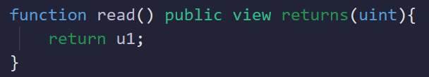

READING STATE VARIABLES
State variables can be read by making the state variable public and clicking on it in the ‘deployed contracts’ section of Remix IDE after deploying the contract
State variables can be accessed and read using functions in the contract (getter function)

Slide 3


INITIALIZATION
State variables can be initialized when they are declared.

Slide 4

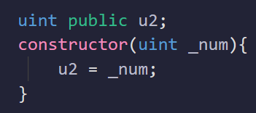

CONSTRUCTOR INITIALIZATION
The constructor is a special function called only once during contract deployment.
We can assign value to State variable via constructor, value in this case will be assigned to the variable on deployment of contract

Slide 5

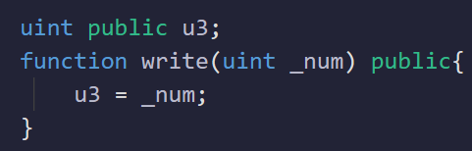

WRITING STATE VARIABLES
State variables can be assigned value using a function as well. In this case value will be assigned when the function is called (setter function). We can modify value using a function as well

